Slide 1

Case Study: Cyclistic Bikeshare
Britta Smith
September 9, 2022

Slide 2



Agenda
Case Study Scenario
About the Data
Summary of data analysis
Bike Choice
Trip Timing
Trip Length
Trip Location
Conclusions and Recommendations
Appendix

Slide 3

Case Study Scenario
Scenario Design by: Google Data Analytics Professional Certificate Program
Scenario Data Analyst: Britta Smith

Slide 4
Case Study Scenario
Cyclistic
Bikeshare options
Cyclistic Riders
Bikeshare company launched in 2016 in Chicago
Features a fleet of 5,824 bicycles that are geotracked and locked into a network of 692 stations across Chicago
Bikes can be unlocked from one station and returned to any other station in the system anytime
Classic bikes
Electric bikes
Assistive options
reclining bikes
hand tricycles
cargo bikes
The majority opt for classic bikes
About 8% use the assistive options
More likely to ride for leisure
About 30% commute to work each day
Pricing plans:
Casual riders: single ride pass or day pass
Members: annual membership

Slide 5
Case Study Scenario
Marketing Team
Team of data analysts responsible for: collecting, analyzing, and reporting data that helps guide Cyclistic marketing strategy.
Marketing Director
Responsible for the development of campaigns and initiatives to promote the bikeshare program
Historical Strategy
Relied on building general awareness, appealing to broad consumer segments
Strategy Change
Notoriously detail-oriented executives will decide whether to approve the recommended marketing program.
My role
Past target
All-new customers with flexible pricing plans to help attract more customers
Finance Analysts
Concluded future growth depends upon maximizing the number of annual members
Campaign to target and convert casual riders into members, who are more profitable
Executives Team
Marketing Team Data Analyst

Slide 6




Case Study Scenario
Business Problem: future success depends upon maximizing the number of annual memberships
Objective: inform formulation of the new “chance to convert” marketing strategy targeting casual rider conversion into annual members

Slide 7
Case Study Scenario: Objective and Purpose
Guide casual rider conversion targeting in the new marketing strategy
Summarize analysis of the Cyclistic historical bike trip data to identify trends
Describe how casual riders and annual members use Cyclistic bikes differently
Make recommendations backed up with compelling data insights

Slide 8

About the data
From what are our data-driven decisions made?

Slide 9
About the Data

Slide 10
About the Data
Source
Data Privacy
License
Motivate International Inc.
Cyclistic Bikeshare in cooperation with the City of Chicago
prohibit using riders’ personally identifiable information
Cannot: connect pass purchases to credit card numbers
Cannot: determine if casual riders live in service area
Cannot: determine if casual riders have purchased multiple single passes
Cyclistic Bikeshare grants non-exclusive, royalty-free, limited, perpetual license to access, reproduce, analyze, copy, modify, distribute in your product or service and use the data for any lawful purpose

Slide 11
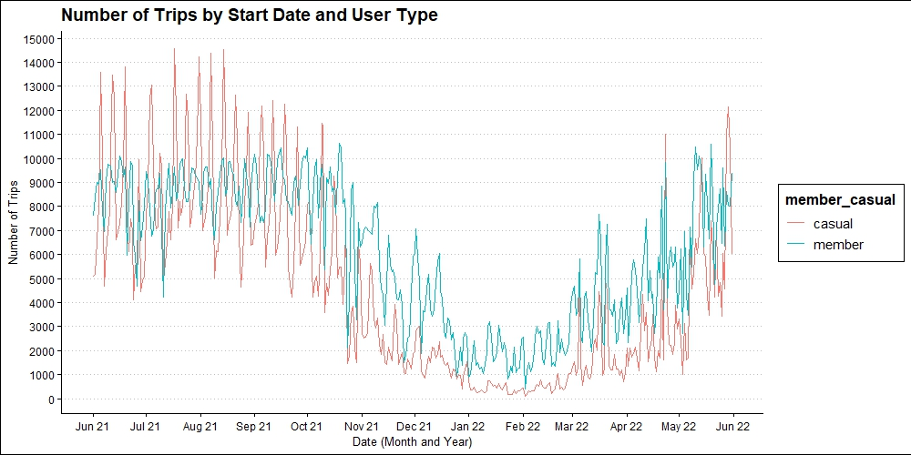
12 Months of Historical Cyclistic Trip Data

Slide 12
About the Data: Variables to Metrics
User type:
Member
Casual rider
Trip identifier:
Unique alphanumeric for each trip
Type of bike chosen for trip:
Classic (traditional bike)
Electric
Datetime
Trip began
Trip ended
Location
Station name and identifier
Start latitude and longitude
End latitude and longitude
Metrics from Datetimes:
Trip length
Trip length category
Ride hour category
Month
Day of week
Date
Hour

Slide 13
About the Data: Metrics and Data Overview

Slide 14
About the data: Limitations and Resolutions
Location
Filtered out geospatial data outside of Chicago service area and 692 station locations
Collected a data frame and spreadsheet of 692 stations with respective coordinates and station identifiers
Assistive bike option data not collected
Included docked bike data as classic, non-electric
Trips data lacks a unique user identification element
Limited analysis to scope of data, repeated trips are meaningful despite lack of unique user identifiers
Timing and length of trips
Transformed data to include trip length in seconds, month, day of week, and time of day all derived from start datetime and end datetime
Trip length skewness apparent and outliers removed to ensure conclusions confidently reflect the population

Slide 15

Comparison and Trends
How do casual riders and members differ in their use of Cyclistic Bikeshare?

Slide 16
Bike Choice
Comparison of casual riders and members by bike choice

Slide 17
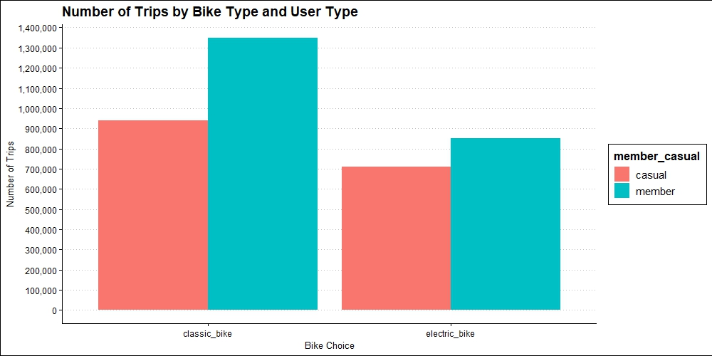
Bike Choice: Over 12 Months of Trips
Classic Bike Percent of All Casual Trips
57%
Classic Bike Percent of All Member Trips
61.3%
Electric Bike Percent of All Casual Trips
43%
Electric Bike Percent of All Member Trips
38.7%
Both casual riders and members made more trips over the 12 month period on classic bikes
Casual rider preference for classic bikes was comparatively less significant
Casual difference in preference of classic bikes by 14%
Member difference in preference of classic bikes by 22.6%

Slide 18

Bike Choice
Do casual riders prefer electric bikes?

Slide 19
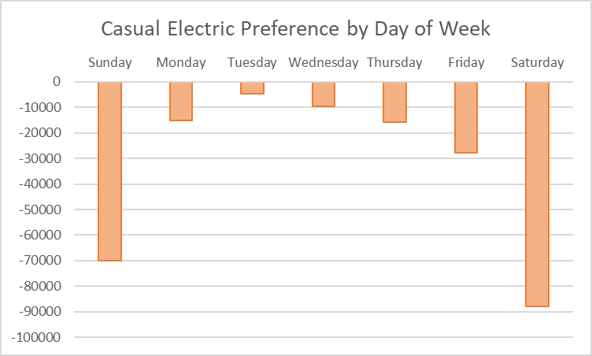
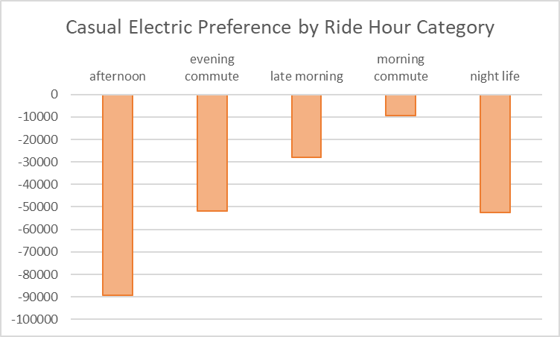
Bike Choice: Casual riders and electric bikes
Preference in terms of number of trips on electric bikes compared to classic bikes over 12 months
Casual riders did not show preference for electric bikes on any day of the week or within any ride hour category
On Tuesdays and during the morning commute, casual rider preference for classic bikes was less pronounced
Only 4,697 more trips on classic bikes on all Tuesdays in 12 months of trips
Only 9,386 more trips on classic bikes on all morning commutes in 12 months of trips

Slide 20
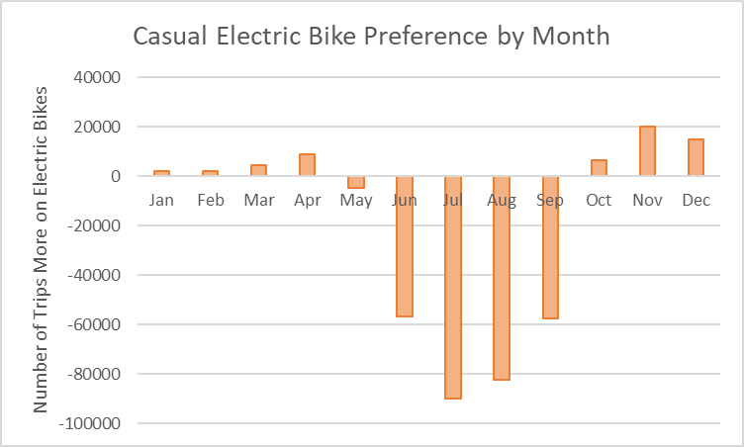
Bike Choice: Casual riders and electric bikes
Casual riders did prefer electric bikes over classic bikes in January through April and October through December
November electric bike trips account for 2.8% of all casual rider trips (46,598 trips)
December electric bike trips account for 1.9% of all casual rider trips (31,411 trips)

Slide 21

Trip Timing
Comparison of casual rider and member trip start times

Slide 22
Trip Timing: Start Time
Comparison of trip number by trip start date and time between casual riders and members

Slide 23
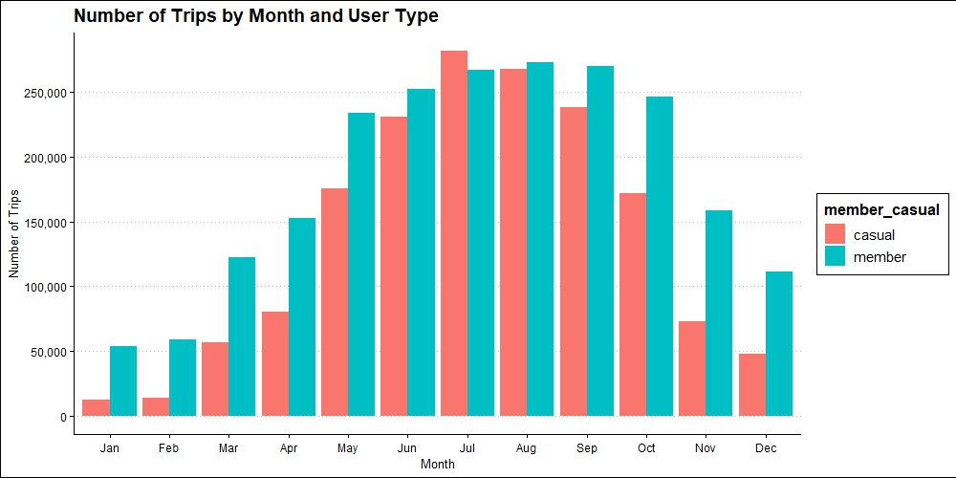
Trip Timing: Start Time by Month
Both casual riders and members took most trips during summer months
Comparatively fewer casual riders took trips during the winter months
Casual riders took 14,920 more trips than members in July
(17% of all casual trips)

Slide 24
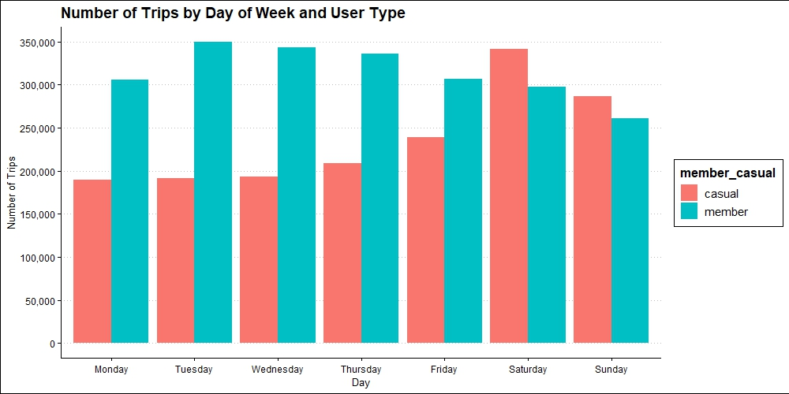
Trip Timing: Start Time by Day of Week
Saturday
44,311 more trips
20.7% of all casual rider trips
Sunday
25,628 more trips
17.4% of all casual rider trips
Members took less trips as the week progressed
Casual riders took more trips as the week progressed
Casual riders took more trips than members on the weekend

Slide 25
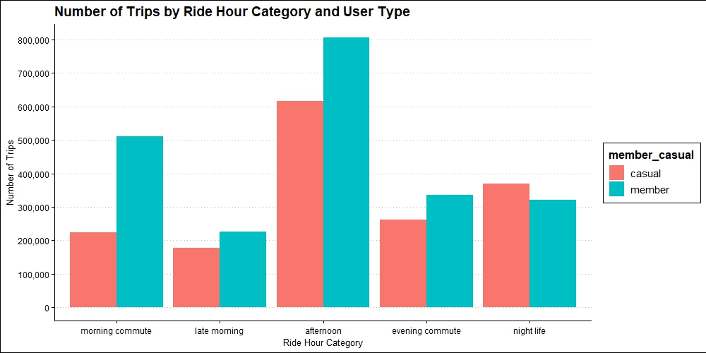
Trip Timing: Start Time by Ride Hour Category
Night life
Casual riders took 50,214 more night life trips
22.5% of all casual trips were night life trips
Both casual riders and members took most trips during the afternoon
Casual riders took more night life trips than members
Night life includes the trip start hours: 0 to 4 and 20 to 23 (12:00 AM to 4:00 AM and 8:00 PM to 11:00 PM)

Slide 26
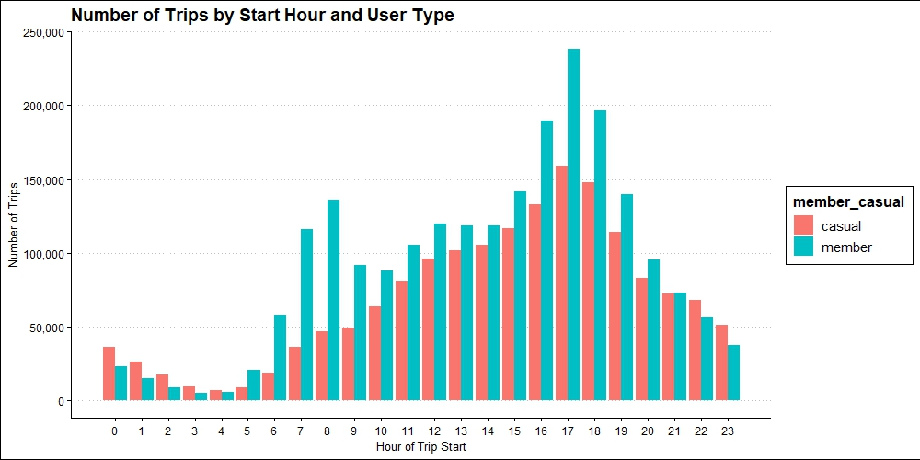

Trip Timing: Start Time by Hour of Trip Start
Both casual riders and member trips trend towards increases from 4:00 AM to a peak at 5:00 PM followed by trip number decrease from 5:00 PM to 4:00 AM
Casual riders do not have a second peak in trip number between 8:00 AM and 9:00 AM
Casual riders began more trips than members during the hours: 0-4 (12:00 AM to 4:00 AM) and 22-23 (10:00 PM to 11:00 PM)
63566 more trips
(13.1% of all casual trips)
Start hours 0-4 (12:00 AM to 4:00 AM)
Casual riders took 38,372 more trips
Start hours 20 and 21 casual riders took 13,332 fewer trips
Start hours 22-23 (10:00 PM to 11:00 PM)
Casual riders took 25,194 more trips

Slide 27
Trip Timing
What does analysis of casual rider afternoon peak trip number reveal?

Slide 28
Trip Timing: Other Trip Start Hours
During the afternoon hours 13-17 (1:00 PM to 5 PM) casual riders took 189,951 less trips than members; however, during this time period:
37.33% of all casual trips began during this period
36.64% of all member trips began during this period

Slide 29
Trip Timing
How do trips during the afternoon and night life compare between casual riders and members?

Slide 30


Trip Timing: Afternoon & Night Life & User Type
Comparatively more casual rider trips:
7 hours during the night life
Casual rider relative preference
Comparatively greater percent composition of all trips
5 hours during the afternoon
Casual rider peak usage
Casual percent of all trips exceeded member percent of all trips during both the night life and afternoon

Slide 31
Trip Timing
How do casual rider trips during the afternoon compare to their trips during the night life?

Slide 32
Trip Timing: Casual Rider Trips in the Afternoon & Night Life
Afternoon
More trips than during the night life
Greater percentage composition of all trips
Night life
Less trips than during the afternoon
Less contribution to total number of trips

Slide 33
Trip Timing
How did trip numbers of July, Saturday, Sunday compare to other months and days?

Slide 34
Trip Timing: Comparing 12 months of Hourly Trip Numbers to July, Saturday, Sunday
Quantifying peak popularity during Saturdays and Sundays in July:
Casual riders took an average of 2,196.896 trips per hour
What months and days of week in the 12 months of trip data are comparable to these times of peak trip number amongst casual riders?
In terms of trip timing with an average greater than or equal to 2,196.896 trips per hour

Slide 35
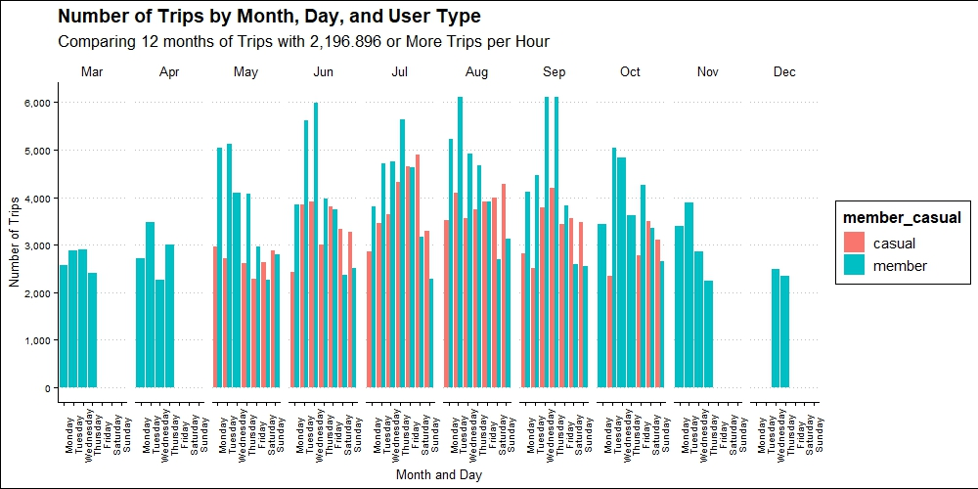
Trip Timing: Comparing 12 months of Hourly Trip Numbers Greater than or Equal to the Saturday & Sunday July Average
At times in May through October casual riders took hourly trips comparable to the Saturday & Sunday July average

Slide 36
Trip Timing: Comparing 12 months of Hourly Trip Numbers Greater than or Equal to the Saturday & Sunday July Average
When during May through October where casual riders BOTH taking a comparable hourly trip number AND taking more trips than members?

Slide 37
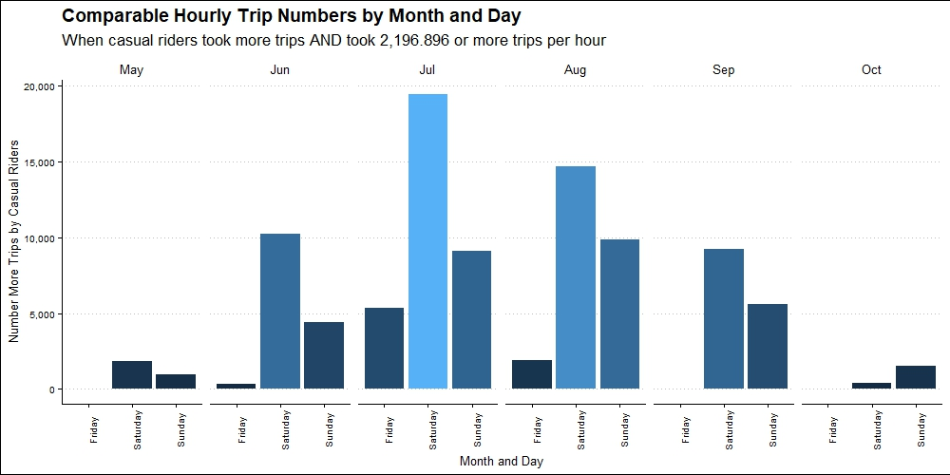
Trip Timing: Comparing 12 months of Hourly Trip Numbers Greater than or Equal to the Saturday & Sunday July Average
Saturdays and Sundays in May, September, and October are casual rider peak usage and peak comparative usage times
Fridays in June, July, and August also had high hourly trip rates and casual rider preference

Slide 38
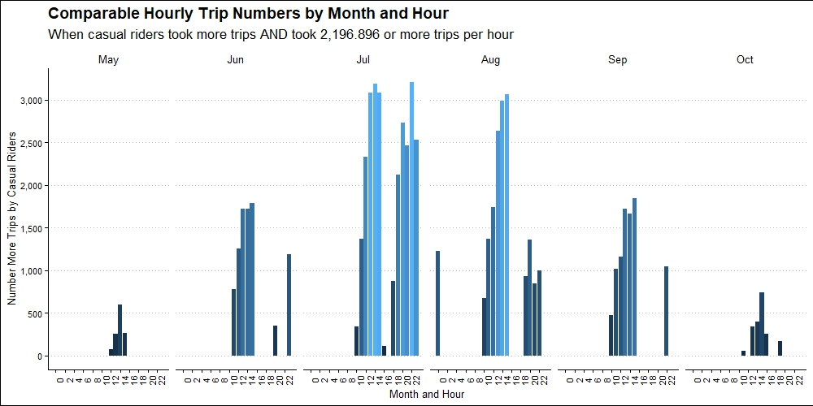
Trip Timing: Comparing 12 months of Hourly Trip Numbers Greater than or Equal to the Saturday & Sunday July Average
12 PM to 3 PM
All hours except 5 PM
All hours except 4 PM to 6 PM
11 AM, 1 PM to 4 PM, and 7 PM
11 AM to 3 PM, and 10 PM to 11 PM
10 AM to 3 PM

Slide 39
Trip Length
How long do casual riders and members ride on any given trip?

Slide 40
Trip Length: Duration of Trips
Comparison of trip length in terms of duration between casual riders and members

Slide 41
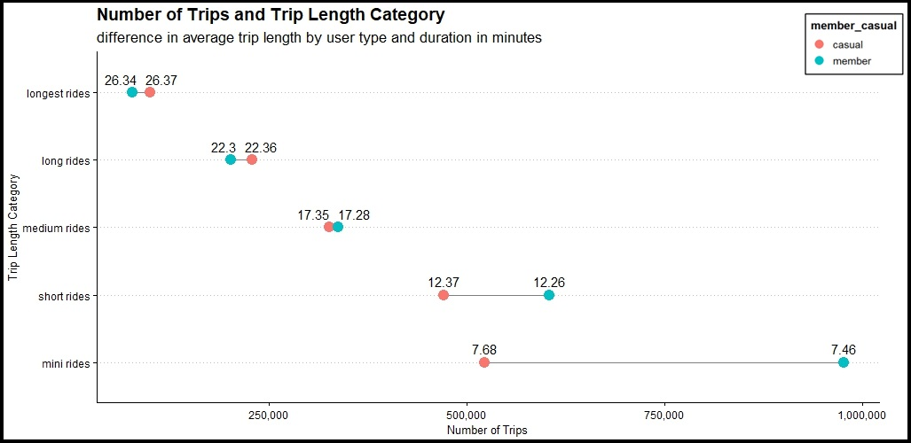
Trip Length: Duration of Trips
longest rides >25 to <=30 min.
21,963 more trips (6.1% of all casual trips)
long rides >20 to <=25 min.
27,838 more trips (13.9% of all casual trips)
Both casual riders and members more mini and short rides and progressively fewer trips as the trip duration lengthens
Casual riders took slightly more long and longest rides
Casual riders took slightly fewer medium rides
Casual riders took significantly fewer short, and mini rides
medium rides >15 to <=20 min.
10,716 fewer trips (19.8% of all casual trips)
short rides >10 to <=15 min. 134,373 fewer trips (28.5% of all casual trips)
mini rides >=5 to <10 min. 454,385 fewer trips (31.7% of all casual trips)

Slide 42
Trip Length: Duration of Trips
Casual riders prefer short and mini trips, just like members…
When did casual riders take short and mini trips?

Slide 43
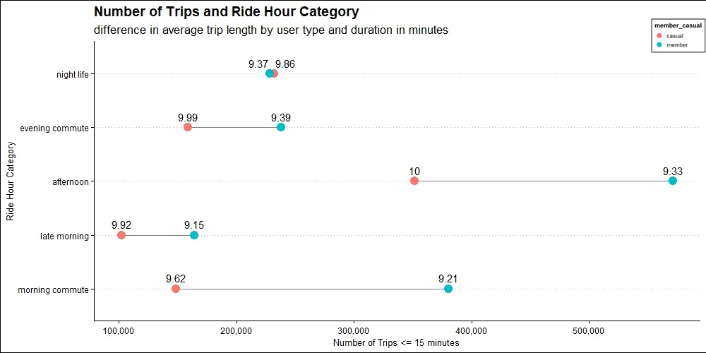

Short & Mini Rides: Trip Timing of Trips <=15 minutes
Most casual rider trips <= 15 minutes were taken in the afternoon ride hour category
351,491 trips
21.3% of all casual rider trips
219,518 trips fewer than members
Night life accounted for the next most popular time casual riders took trips <= 15 minutes
232,333 trips
14.1% of all casual rider trips
3,740 trips more than members

Slide 44
Trip Length: Duration of Trips
19.8% of all casual rider trips were medium rides >15 to <=20 min.
When did they take these medium rides?

Slide 45
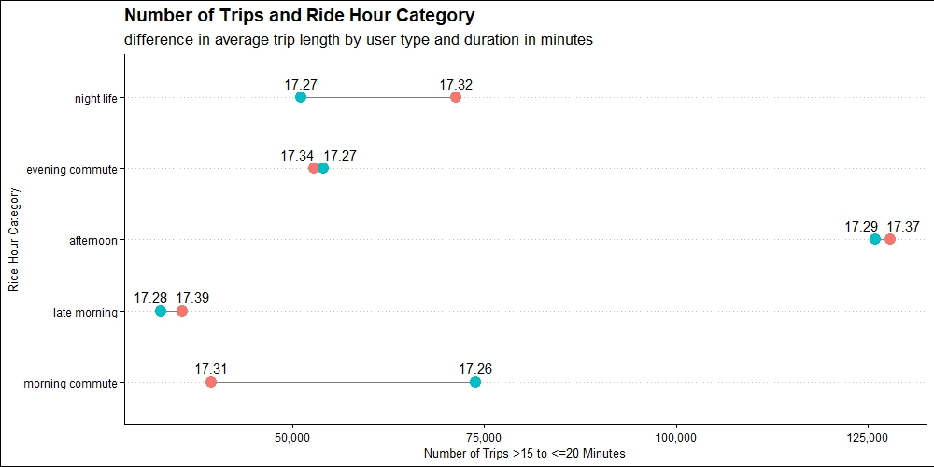

Medium Rides: Trip Timing of Trips >15 to <=20 min.
Most medium rides of casual riders were in the afternoon
127,875 trips
7.7% of all casual trips
1,931 trips more than members
Night life was the next most popular time to take medium rides
71,315 trips
4.3% of all casual trips
20,238 trips more than members
During the late morning, casual riders also took more trips than members
35,619 trips
2.2% of all casual trips
2,771 trips more than members

Slide 46
Trip Length: Duration of Trips
Trips >= 5 minutes and <= 20 minutes were common trip duration for casual riders
How do casual trip numbers in the mini, short, and medium ride categories compare to members?

Slide 47
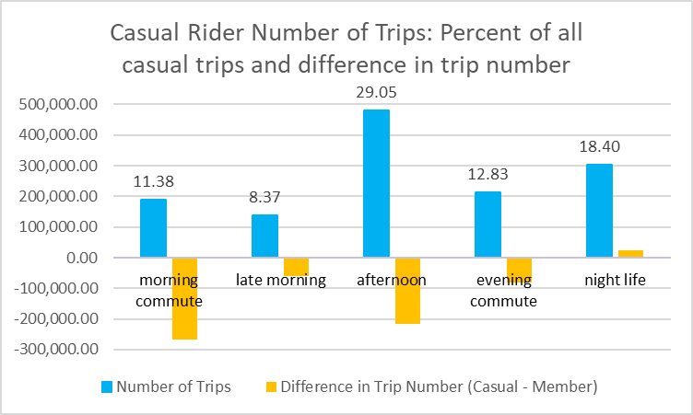
Cumulative: Mini, Short, and Medium Rides
Casual riders took 23,978 more trips >= 5 minutes to <= 20 minutes than members during the night life
18.4% of all casual trips
Casual riders took most trips >= 5 minutes to <= 20 minutes during the afternoon
29.1% of all casual trips
217,587 less trips than members

Slide 48

Who What When …
…Where!

Slide 49
Trip Location
How do casual riders compare to members in where they took trips?

Slide 50
Trip Location: Station Regions
The Big Picture…
Where do casual riders prefer to ride?

Slide 51
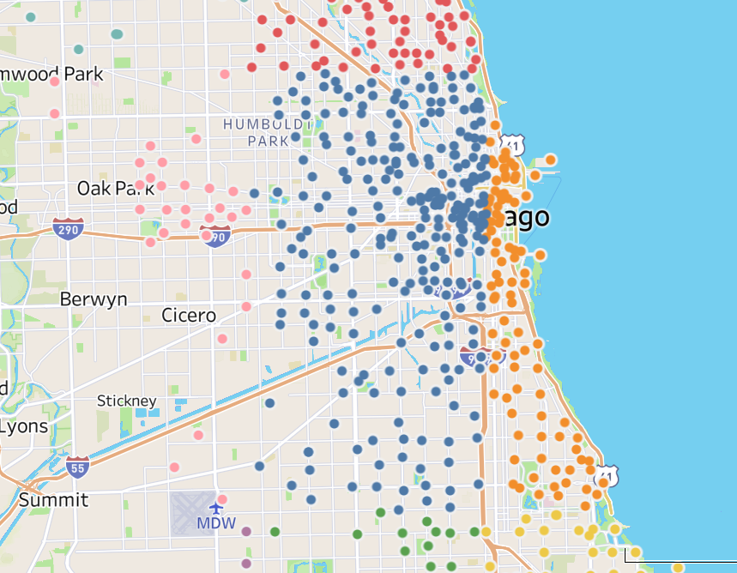
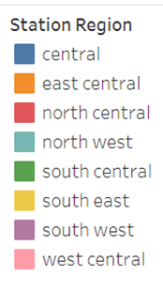
Trip Location: Most Common Travel Region in 12 months of Trips
Both casual riders and members took most trips within the central station region

Slide 52
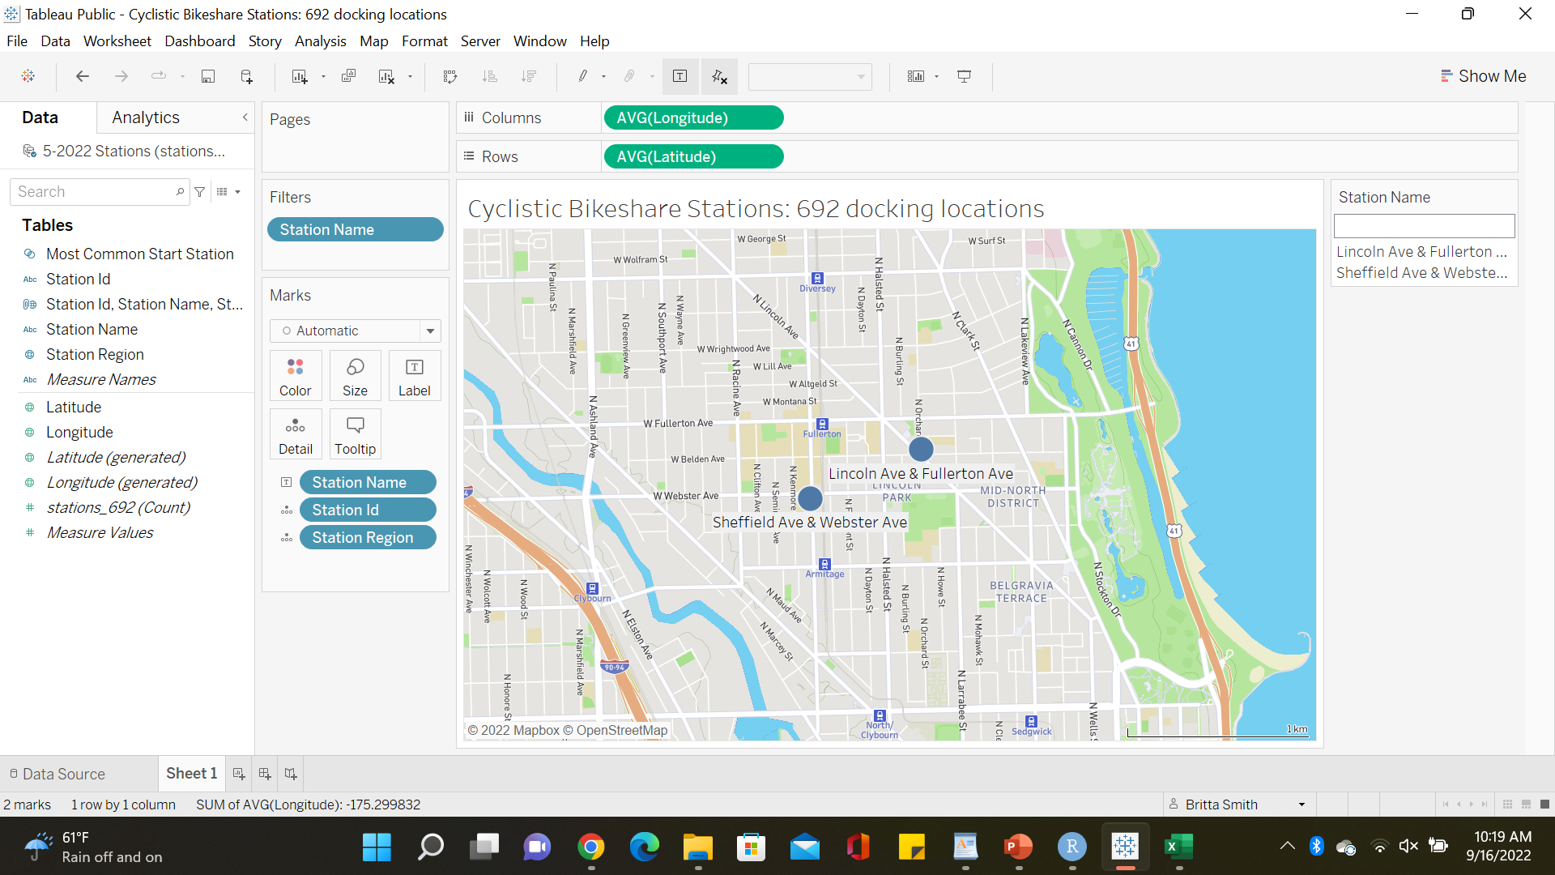
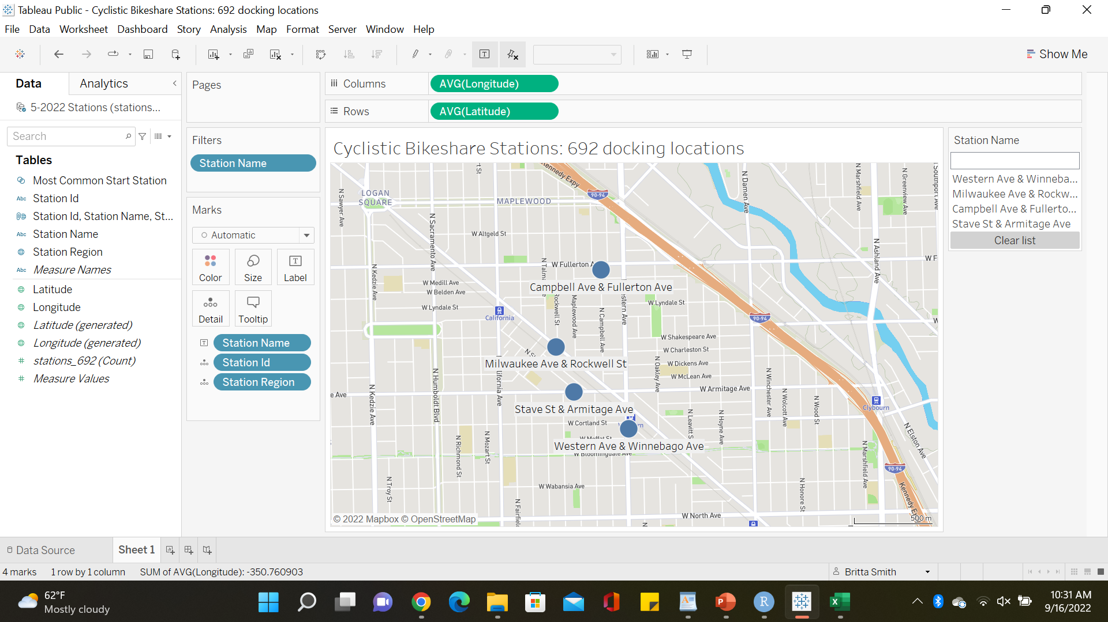

Trip Location: Most Common Start and End Locations in 12 months of Trips
Both casual riders and members had the same most common start location
Members had a most common end location east of Kennedy Expressway
Casual riders had the same most common start and end locations
----

Slide 53
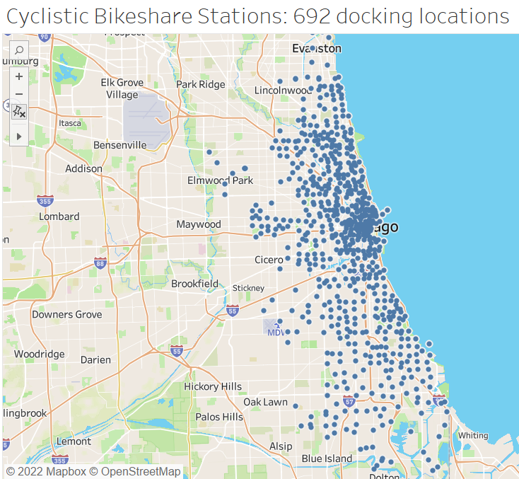
Trip Location
Zeroing in…
How do casual riders and members compare with respect to travel within each station region?

Slide 54
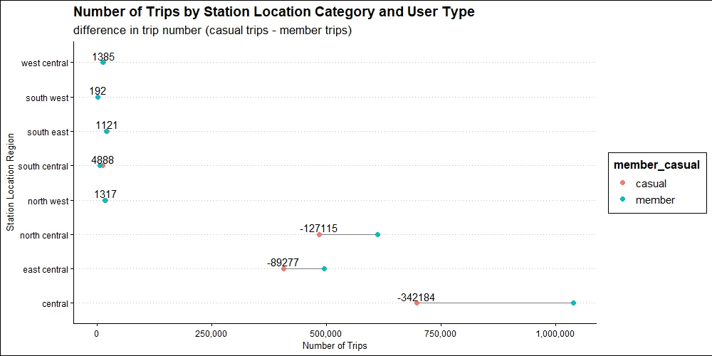
Trip Location: Comparison of Travel within 8 Station Regions
Both casual riders and members utilize these 3 central regions most.
Casual riders took significantly less trips than members.
96% of all casual trips took place in these 3 central regions (42% in central alone)
Casual riders took more trips than members in these 5 station regions.
4% of all casual trips took place in these regions

Slide 55
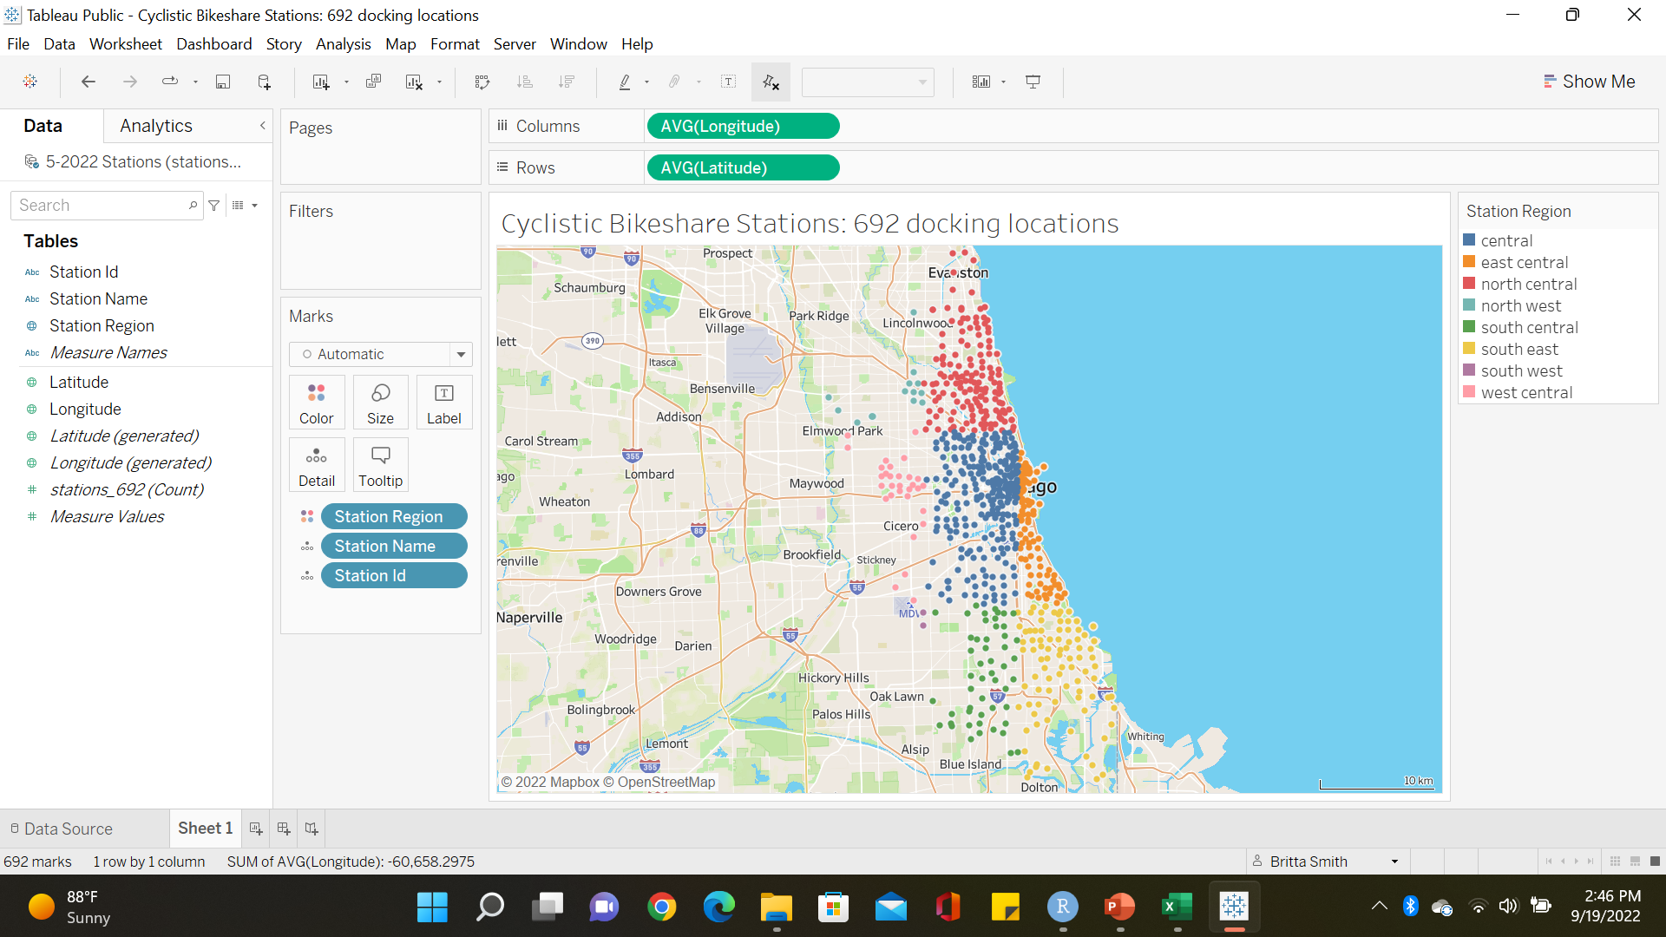
Trip Location: Comparison of Travel within 8 Station Regions
Most trips: Both casual riders and members
These 3 regions are closest to central Chicago
Casual riders took more trips than members in 5 regions. These 5 station regions are further from central Chicago

Slide 56
Trip Location: Most Common Travel Region
Casual riders and members prefer to travel in the central station region
How do casual riders uniquely travel within this region?

Slide 57
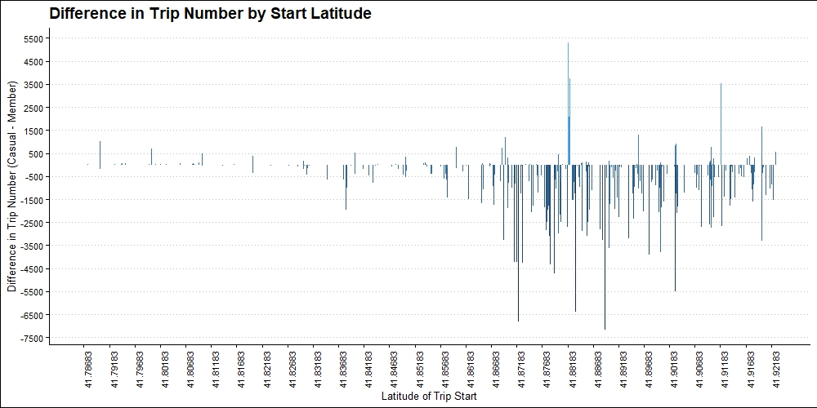
Start Latitudes of the Central Station Region
12 start latitudes had 500 more trips made by casual riders within the central station region

Slide 58
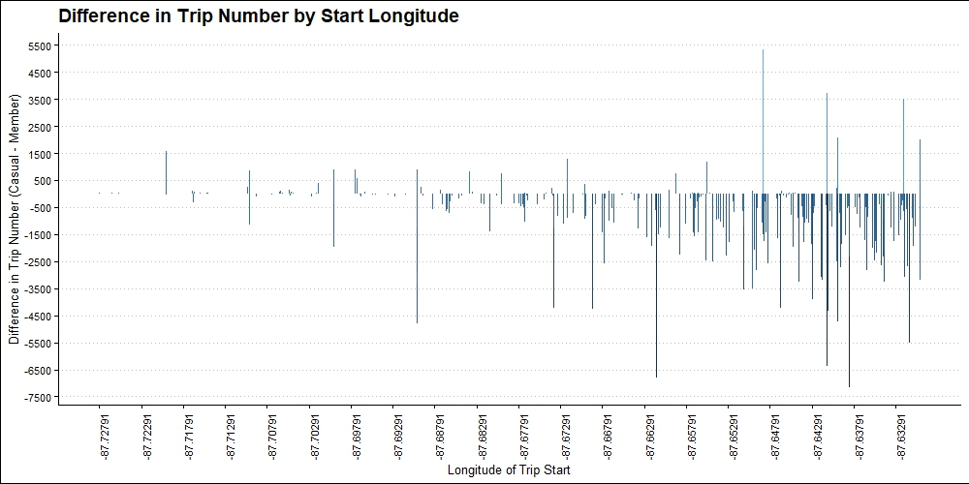
Start Longitudes of the Central Station Region
12 start longitudes had 500 more trips made by casual riders within the central station region

Slide 59
Trip Location: 12 Key Central Start Latitudes and Longitudes
What stations correspond to these start latitudes and longitudes with 500 more trips made by casual riders when compared to members?

Slide 60
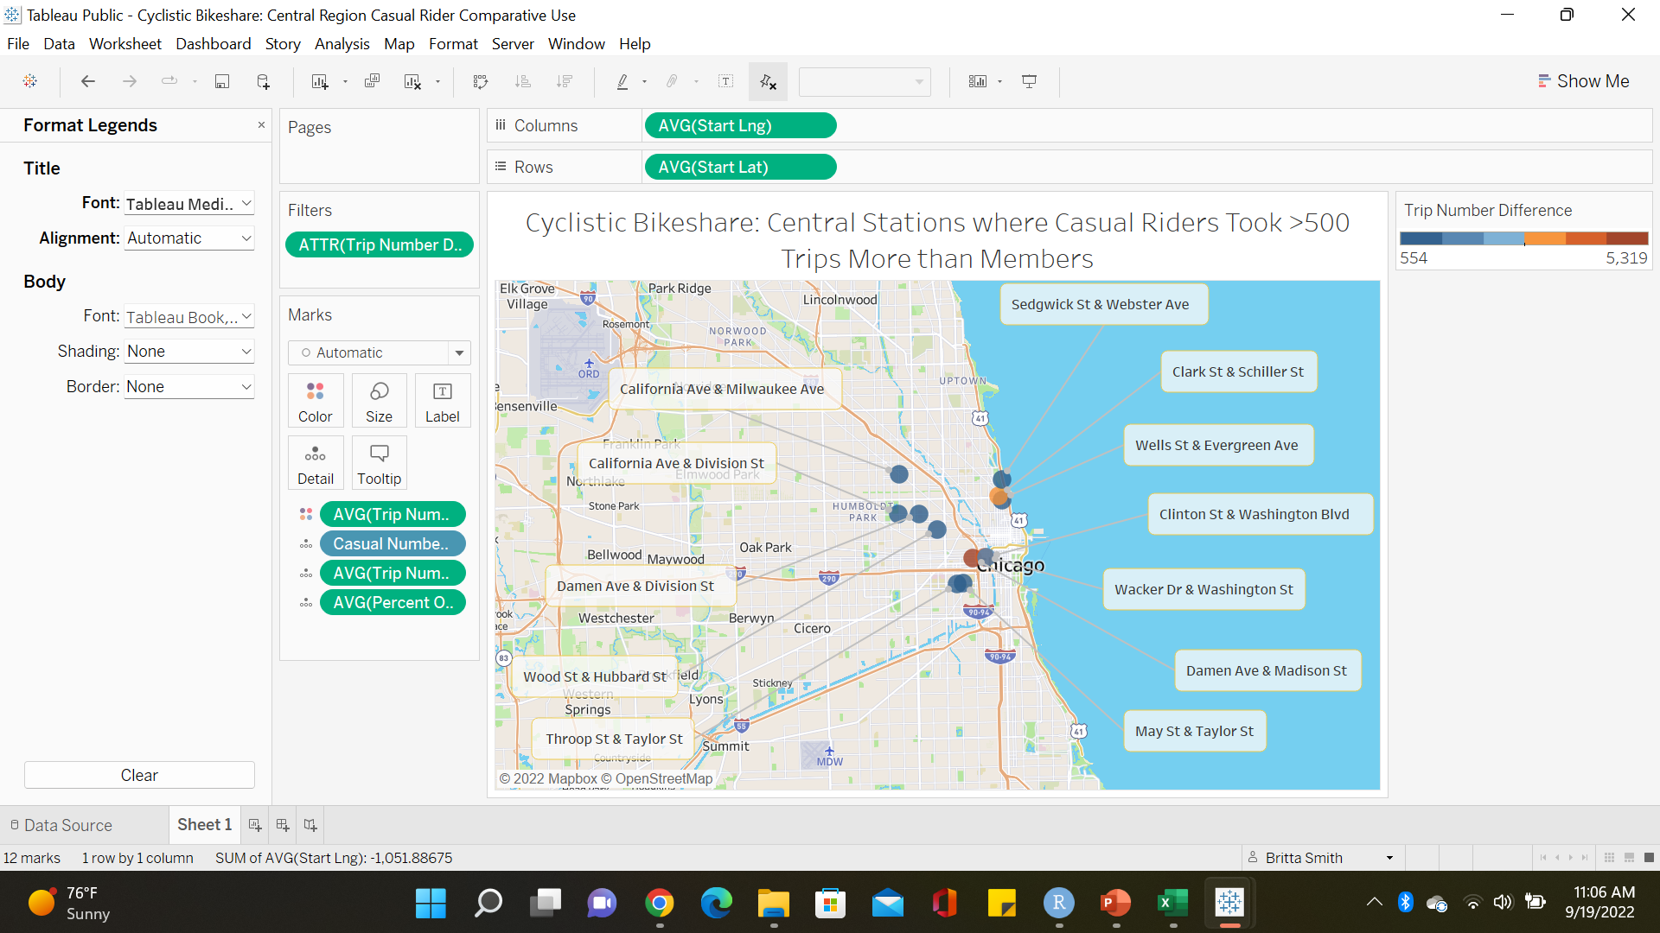
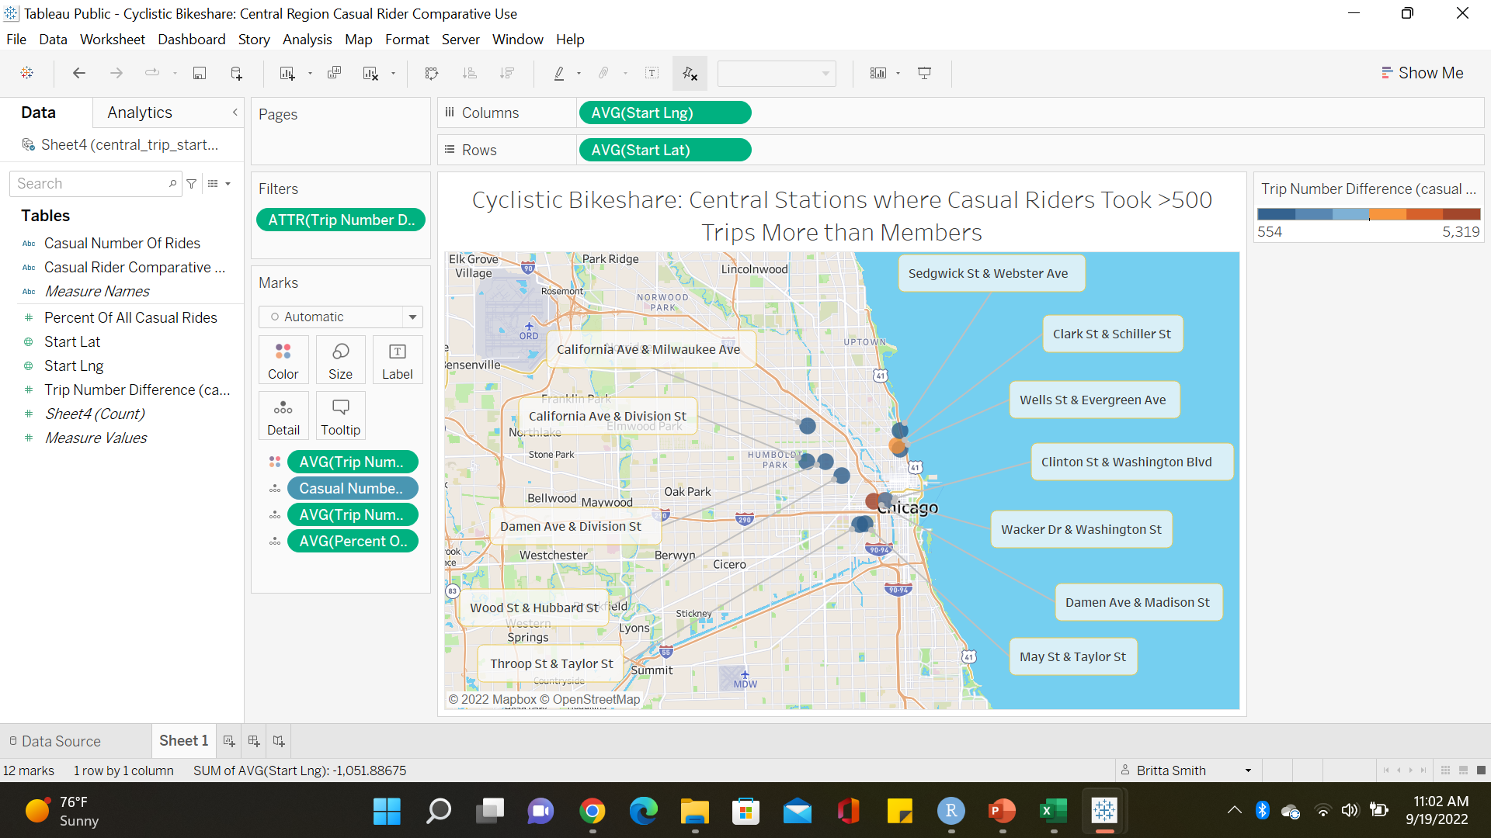
Trip Location: 12 Key Central Start Latitudes and Longitudes
Where do these stations lie within the bigger picture of the central station region?

Slide 61
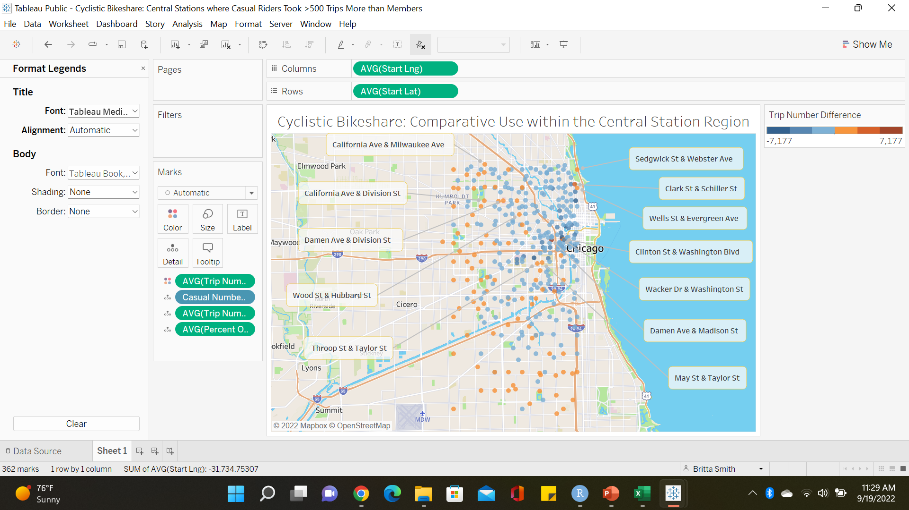
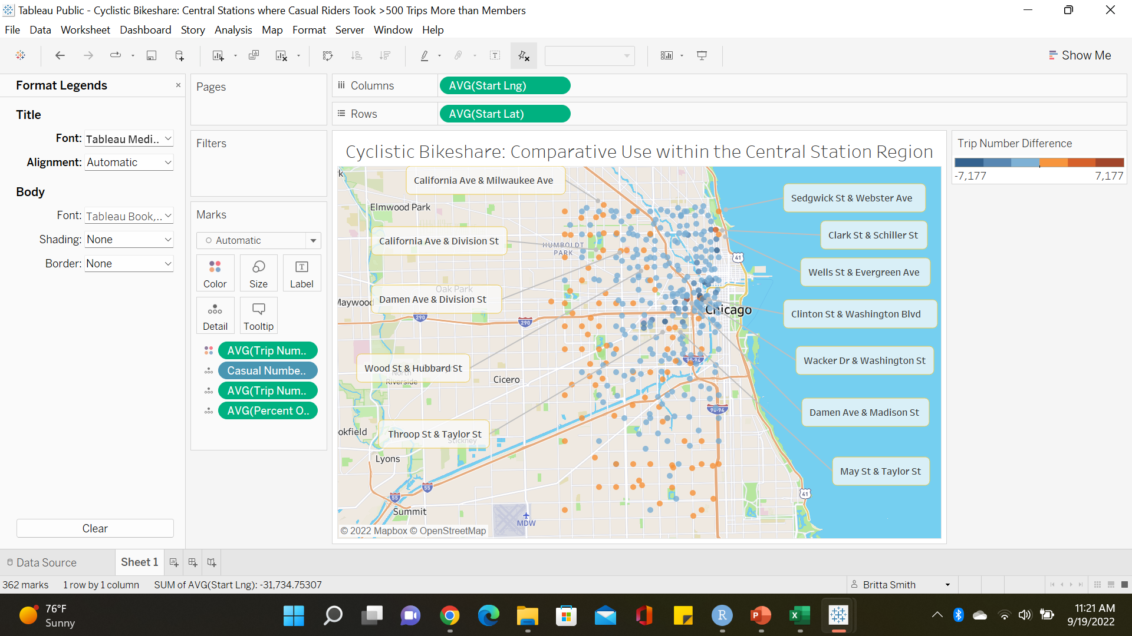
Trip Location: 12 Key Central Start Latitudes and Longitudes
The bigger picture reveals casual riders commonly frequent outlying areas within the central region
This is visualized by noticing how there is an inner cluster of blue dots compared to the outer scattering of orange dots which represent more casual trips at those location

Slide 62
Trip Location: Central Station Region
How does casual use of the outlying central region compare to the downtown central region?

Slide 63
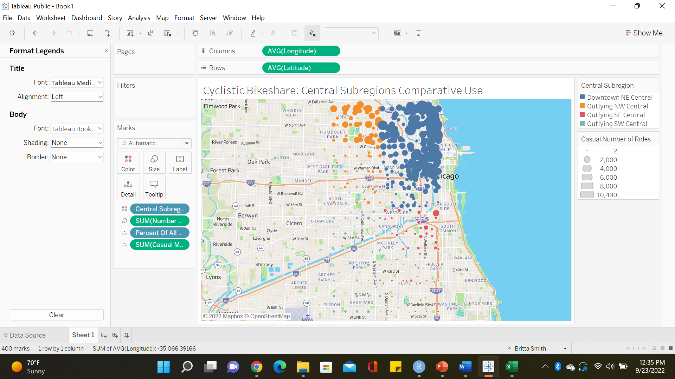
Trip Location: Outlying Central versus Downtown Central Region
Central Subregions:
Downtown central: Northeastern quadrant of central region; latitude >41.855 to <=41.923 and longitude >-87.68 to <=-87.63
Outlying central: Northwestern, southwestern, and southeastern quadrants of central region; latitude >41.7867 to <= 41.855 and longitude >-87.73 to <=-87.63 minus downtown central

Slide 64
Trip Location: Outlying Central versus Downtown Central Region
Downtown NE Central: 23.9% of all casual trips
Outlying NW Central: 4.31% of all casual trips
Outlying SW Central: 0.44% of all casual trips
1,825 more trips than members
Outlying SE Central: 0.86% of all casual trips
All Outlying Central:
5.62% of all casual trips

Slide 65
Conclusions and Recommendations
Bike Choice
Trip Timing
Trip Length
Trip Location

Slide 66
Bike Choice
Summary
Conclusions
Recommendations
Rationale

Slide 67
Bike Choice: Conclusion and Summary
Summary
Conclusions
The percent of casual rider trips on classic bikes was 14% greater than the percentage of their trips on electric bikes, a smaller difference than seen in member trips
Casual riders took more trips on electric bikes than on classic bikes in the following months: January, February, March, April, October, November, and December
This analysis creates a promising hypothesis of casual rider interest in electric bikes
It is prudent to ensure marketing expenditures and cost of increasing electric bike availability is of mutual import and benefit

Slide 68
Moving Forward: Bike Choice

Slide 69

Moving Forward: Bike Choice
Recommendation:
Focus: collection of more data to ensure insights warrant action, and to identify what actions provide the greatest opportunity

Slide 70
Bike Choice: Recommendations
Recommendations
Details
Casual rider survey
Continue to monitor trends
Additional data collection
Utilize a casual rider survey to explore bike choice preferences further
Continue to monitor bike choice trends
Additional data collection
Electric bike choice data around the following times: Tuesdays, morning commute hours, January to April and October to December
Begin to collect data on choice of assistive bike options

Slide 71
Trip Timing
Summary
Conclusions
Recommendations
Rationale

Slide 72
Trip Timing: Summary and Conclusions
Casual rider peak usage and more trips than members
July
Saturdays and Sundays
Casual rider peak usage
Afternoon
More trips than members
Night life
Throughout the year times key times include Saturdays, Sundays, afternoon, and night life
A key month is July

Slide 73
Trip Timing: Summary and Conclusions
Quantifying peak usage can be done by looking at July Saturday and Sunday hourly trip rate
Comparison to this hourly trip rate reveals times of comparable hourly trip rates:
May - October
Fridays in June – August
Saturdays and Sundays in May, September, and October
May 12 PM to 3 PM, June 11 AM to 3 PM, and 10 PM to 11 PM, July all hours except 5 PM, August all hours except 4 PM to 6 PM, and September 10 AM
In addition to July, the months of May through October are popular trip times amongst casual riders
In addition to Saturdays and Sundays, Fridays in June through August are also popular days amongst casual riders
Analysis of specific comparable hours only looks at a small percentage of casual trips : number of trips in output ranged from 2,202 to 4,899 casual trips per hour

Slide 74
Moving Forward: Trip Timing

Slide 75
Moving Forward: Trip Timing
Recommendation:
Focus: peak usage times
How to target: during each month target the days and times of peak usage

Slide 76
Trip Timing: Recommendations and Rationale
June & August
July
January – May & September – December
Saturdays and Sundays
During the afternoon and night life ride hour categories
Saturdays, Sundays, the afternoon, and night life where peak usage times throughout the year
Fridays, Saturdays, and Sundays
During the afternoon and night life ride hour categories
Fridays had peak hourly usage rates
Mondays – Sundays
During the afternoon and night life ride hour categories
The entirety of July represents a peak usage time
July Monday – Thursday were also significant peak usage days
*see appendix and month_day_time_v2

Slide 77
Trip Timing: Rationale of Target Times
July + Mondays – Sundays + Afternoon & Night life
Inclusion of Monday – Thursday is supported by the analysis of individual trip timing metrics and supported by analysis of the month_day_time* data frame hourly difference in trip number
This revealed that Monday – Thursday included both high casual trip numbers and more trips than members with exceptions largely at 4 PM and 5 PM
Exclusion of hourly findings compared to peak hourly rates
Areas for further investigation, due to small number of trips generated in the output

Slide 78
Trip Length
Summary
Conclusions
Recommendations
Rationale

Slide 79
Trip Length: Summary and Conclusion
Timing:
of all lengths
Mini, short, & medium rides (<= 20 minutes)
Long & longest rides (>20 to <=30 minutes)
Afternoon: most popular time for casual trips
Night life: 2nd most popular time for casual trips
80% of all casual rider trips
The greatest opportunity to convert or ability to target the most trips
20% of all casual rider trips

Slide 80
Moving Forward: Trip Length

Slide 81
Moving Forward: Trip Length
Recommendation:
Focus: the duration of travel with the largest percentage of casual rider trips
How to target: by targeting trip timing simultaneously

Slide 82
Trip Length: Recommendations and Rationale
Recommended targets
rationale
Casual rider trip lengths less than or equal to 20 minutes
How to target these trips:
Afternoon and night life trips, which is already done should trip timing recommendations be accepted
While casual riders took 599,474 fewer trips of this length, rides less than or equal to 20 minutes accounted for 80% of all casual riders’ trips
Presents the opportunity to convert 1,320,448 trips into additional member trips if this trip length is considered
Analysis of trip timing of mini, short, and medium rides (those <or= 20 minutes) reveals that targeting these also captures the comparative preference for night life travel while also targeting the casual rider afternoon peak usage time
While casual riders took 49,801 more trips longer than 20 minutes, these rides only accounted for 20% of all casual rides, like the percentage of medium rides alone, 19.8%
Only an opportunity to convert 329,555 trips
Popular times are already targeted with trip timing recommendations: afternoon and night life

Slide 83
Trip Location
Summary
Conclusions
Recommendations
Rationale

Slide 84
Trip Location: Summary and Conclusions
96 % of all casual rider trips
42% of all casual rider trips alone
North central
> 41.9233, >-87.73 to <=-87.63
Central
> 41.7867 to <= 41.9233, >-87.73 to <=-87.63
East central
> 41.7867 to <= 41.9233, >-87.63
These three stations are where casual riders traveled the most
Central region
Other stations
Only 4% of all casual rider trips
Of these three stations, the central region was the most popular

Slide 85
Trip Location: Summary and Conclusions
23.9% of all casual trips
5.62% of all casual trips
Downtown north east central subregion
Within the central region, the downtown north east central subregion was the most popular
Outlying south west central subregion
Outlying north west central subregion
Outlying south east central subregion
While still utilized, these central subregions, they saw comparatively much less travel than the north east central subregion

Slide 86
Moving Forward: Trip Location

Slide 87
Moving Forward: Trip Location
Recommendation:
Focus: areas most frequently utilized by casual riders
Areas: regions, subregions, and stations

Slide 88
Trip Location: Recommendations and Rationale
Target Regions
Target Central subregion
Central, east central, and north central
Opportunity to convert 1,586,411 casual trips into additional member trips
696,475, 405,857, 484,079 trips respectively
Focus on the greatest opportunity
The remaining regions
Only account for 63,592 casual rider trips cumulatively, and thus can be low priority
Downtown north east central subregion
Potentially targets 394,370 casual rider trips
Zero in on the greatest gains within the greatest opportunity

Slide 89
Trip Location: Recommendations and Rationale
Central stations
Central stations
These two stations has the highest casual rider trip numbers:
Lincoln Ave & Fullerton Ave
Sheffield Ave & Webster Ave
Stations comparatively more popular amongst casual riders:
Throop St & Taylor St, May St & Taylor St, Damen Ave & Madison St, Clinton St & Washington Blvd, Wacker Dr & Washington St, Wood St & Hubbard St, California Ave & Division St, Damen Ave & Division St, Wells St & Evergreen Ave, Clark St & Schiller St, Sedgwick St & Webster Ave, California Ave & Milwaukee Ave
Especially Damen Ave & Madison with 5,319 more casual trips, Wacker Dr & Washington St with 3,735 more casual trips, and Clark St & Schiller St with 3,516 more casual trips

Slide 90
Trip Location: Potential Limitations
Placing the south west, south central, south east, west central and north west regions as low priority
Possibly forgoes the greatest potential for bike share member growth and diversification
When paying attention to specific stations mentioned, it may be helpful to include five surrounding stations
Geotracking data by nature of its collection can be less accurate based on surroundings
Obstruction reduces accuracy as with indoor use, nearby buildings, and/or trees

Slide 91


Thank You
Britta Smith
Email Address: bretana1226@gmail.com

Slide 92
Appendix
Links to supporting documents

Slide 93
Appendix
Raw data: https://divvy-tripdata.s3.amazonaws.com/index.html
Cleaned data: https://www.kaggle.com/datasets/brittasmith/cyclistic-bikeshare-clean-data-rdata
See directions on access: https://github.com/brittabeta/Cyclistic-Bikeshare-Case-Study/blob/main/Appendix
Data cleaning and changes: https://github.com/brittabeta/Cyclistic-Bikeshare-Case-Study/blob/main/Changelog.docx
R code: https://github.com/brittabeta/Cyclistic-Bikeshare-Case-Study
See part 1 through part 7
Tableau visuals: https://public.tableau.com/app/profile/britta.smith

Slide 94
Appendix
R code output spreadsheets: https://www.kaggle.com/datasets/brittasmith/cyclistic-bikeshare-clean-data-rdata
See directions on access: https://github.com/brittabeta/Cyclistic-Bikeshare-Case-Study/blob/main/Appendix
R code output visuals: https://www.kaggle.com/datasets/brittasmith/cyclistic-bikeshare-clean-data-rdata
See directions on access: https://github.com/brittabeta/Cyclistic-Bikeshare-Case-Study/blob/main/Appendix
Rationale to include Monday – Thursday
See https://www.kaggle.com/datasets/brittasmith/cyclistic-bikeshare-clean-data-rdata?
See file month_day_time_v2.xlsx
Select sheet titled: “for appendix”

